Slide 1
[Computer Architecture and Operating Systems]
Lecture [8]
[ File Concept ]

Slide 2
Agenda
Week 8 Lecture Coverage
  File concept
  Access methods
  Directory structure
  Protection

Slide 3
Learning Objectives
On successful completion of this lecture, students will be able to demonstrate:
  Understand different file systems
  Understand file processing system

Slide 4
Review of Week 7 (1)
From last week we should have understood:
  Process Management
  Process Creation
  Process Termination
  Process Stages
  Process Scheduling

Slide 5
Review of Week 7 (2)
What are the components three state process model?
Why process termination is important part of process management and What happens if process never terminates ?

Slide 6
FILE CONCEPT

Slide 7
File Concepts
File: sequence of bits and lines whose meaning is defined by the file’s creators and recorded in a secondary storage.
  Text files
    binary
    numeric
    character
  Source file
  Program (executable file)
Pass it through a complier
Source file
executable file

Slide 8
File type | Usual extension | Function
Executable | exe, com, bin | Read to run machine language program
Object | obj, o | Compiled, machine language
Source Code | C, java, py, asm, a | Source code in various languages
Batch | bat, sh | Commands to the command interpreter
Text | txt | Textual data, documents
Word Processor | wp, tex, rrf, doc | Various word processor formats
Archive | arc, zip, tar | Related files grouped into one compressed file
Multimedia | mpeg, mov, rm | For containing audio/video information

Slide 9
File Structure
  Simple record structure
    Fixed length
    Variable length
  Complex Structures
  Formatted document
  Re-locatable load file
  Who decides:
    Operating system
    Program

Slide 10
File Attribute
  Name – only information kept in human-readable form
  Identifier – unique tag (number) identifies file within file system
  Type – needed for systems that support different types
  Location – pointer to file location on device
  Size – current file size
  Protection – controls who can do reading, writing, executing
  Time, date – creation, modification and deletion
  user identification – data for protection, security, and usage monitoring
  Information about files are kept in the directory structure, which is maintained on the disk

Slide 11
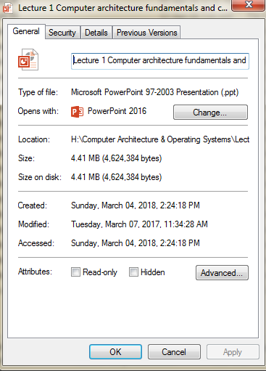
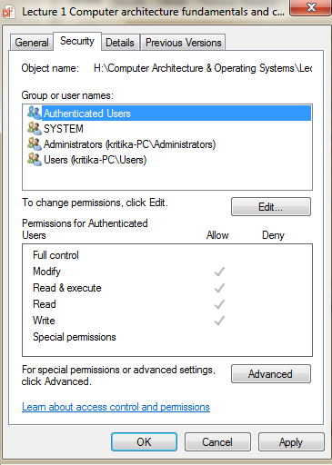
Name
Type
Location
Size
Time and Date
Permission

Slide 12
File operations
File Create operation
File Delete operation
File Open operation
File Close operation
File Read operation
File Write operation
File Append operation
File Seek operation

Slide 13
What does it mean to open a file?
  Several pieces of data are needed to manage open files:
    File pointer: pointer to last read/write location, per process that has the file open
    File-open count: counter of number of times a file is open – to allow removal of data from open-file table when last processes closes it
    Disk location of the file: cache of data access information
    Access rights: per-process access mode information

Slide 14
File Access Method
1) Sequential Access
Implemented by the file system.
• Data is accessed one record right after the last.
• Reads cause a pointer to be moved ahead by one.
• Writes allocate space for the record and move the pointer to the new End Of File.
• Such a method is reasonable for tape

Slide 15
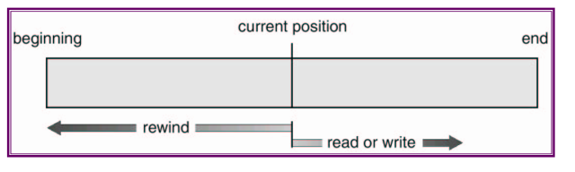
File Access Method
  Supports following operations:
  read next
  write next
  Rewind
  Reset
  Skip

Slide 16
File Access Method
2) Direct Access
Method useful for disks.
• The file is viewed as a numbered sequence of blocks or records.
• There are no restrictions on which blocks are read/written in any order.
• User now says "read n" rather than "read next".
  • "n" is a number relative to the beginning of file, not relative to an absolute physical disk location. n = relative block number

Slide 17
File Access Method
  Supports following operations:
  read n
  write n
  position to n / jump to record n
  Query current record
  read next
  write next
  rewrite n

Slide 18
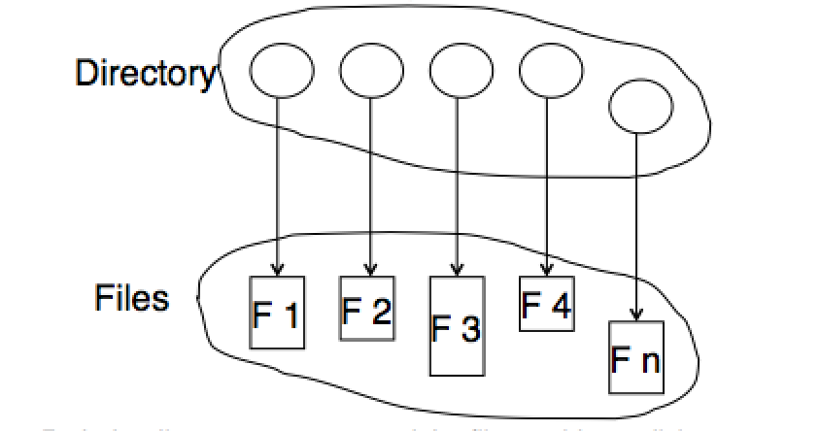

Directory Structure
  A collection of nodes containing information about all files
  a directory is a file system cataloging structure which contains references to other computer files, and possibly other directories.

Slide 19
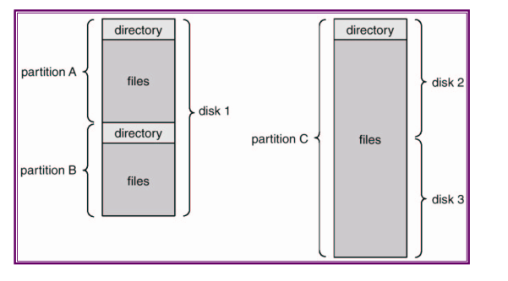


Typical File System Organization

Slide 20
Operations performed on a directory
  Search for a file
  Create a file
  Delete a file
  List files and directories
  Rename a file
  Create directory
  Remove directory

Slide 21
Organizing a directory
  Efficiency – locating a file quickly
  Naming – convenient to users
  Two users can have same name for different files
  The same file can have several different names
  Grouping – logical grouping of files by properties, (e.g., all Java programs, all games, …)

Slide 22
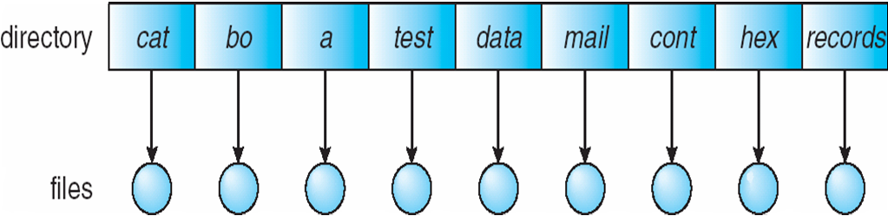
Single level directory
  A single directory for all users
    Naming problem
    Grouping problem

Slide 23
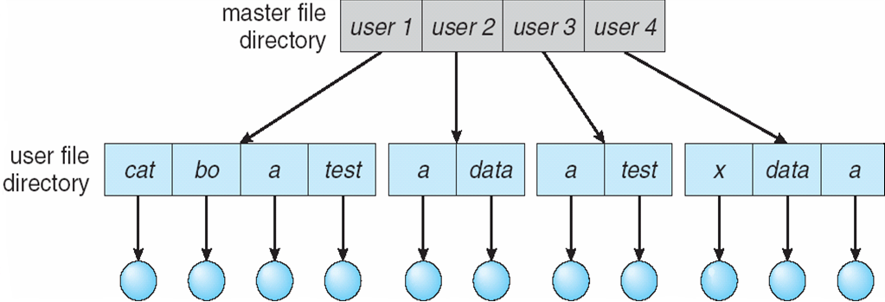
Two level directory
  Separate directory for each user
  Path name
  Can have the same file name for different user
  Efficient searching

Slide 24
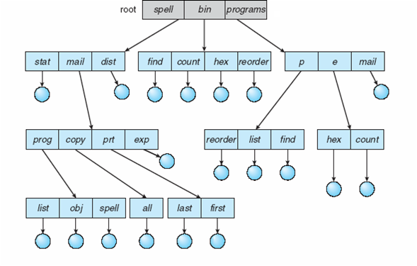
Tree structured directory
    Efficient searching
    Grouping Capability
    Current directory (working
    directory)
    Get to directory last from
    root
      cd /spell/mail/prt/last

Slide 25
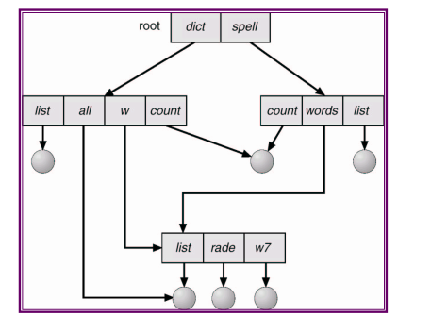
Acyclic-Graph Directories
Have shared sub directories and files

Slide 26
Protection
File owner/creator should be able
to control:
  what can be done
  by whom
Types of access
  Read
  Write
  Execute
  Append
  Delete
  List

Slide 27
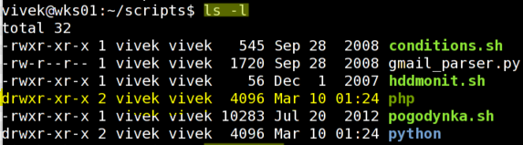
Protection
Mode of access: read, write, execute
Three classes of users
Owner access | RWX | 111 | 7
Group access | RWX | 110 | 6
Public access | RWX | 001 | 1

Slide 28
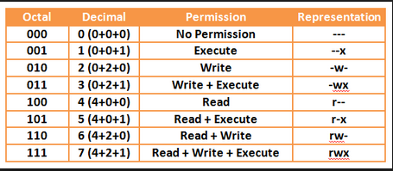

Protection
For a particular file (say game) or subdirectory, define an appropriate access.
Read | R | 4
Write | W | 2
execute | x | 1

Slide 29

Q&A ?

Slide 30
Summary
In this lecture we discussed
  File concept
  Access methods
  Directory structure
  Protection

Slide 31
Workshop
Learn how to create file and directory permissions on Linux operating system

Slide 32


